Slide 1


Portafolio listado comercial

Slide 2


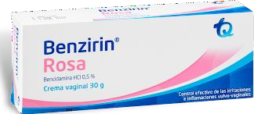
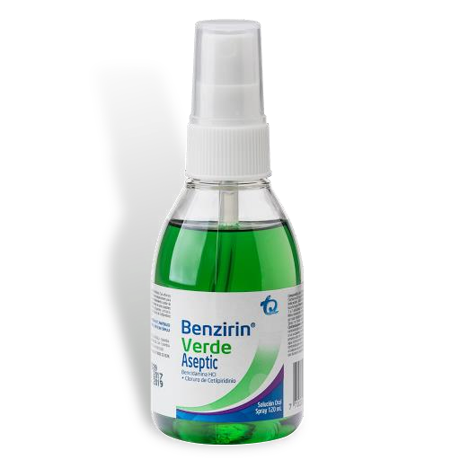
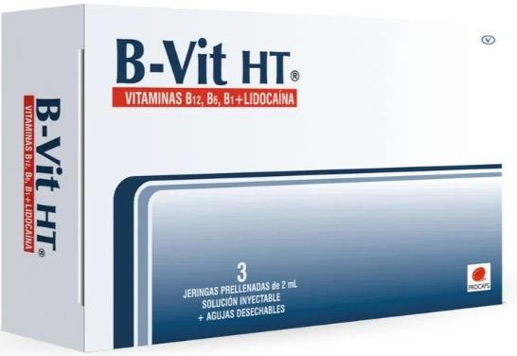
NF
BENZIRIN ROSA CREMA VAGINAL 30 GR $48.624
BENZIRIN VERDE ASEPTIC 120 ML
$27.840
B-VIT HT 3 AMPS JERINGA PRELLENADA $53.840

Slide 3
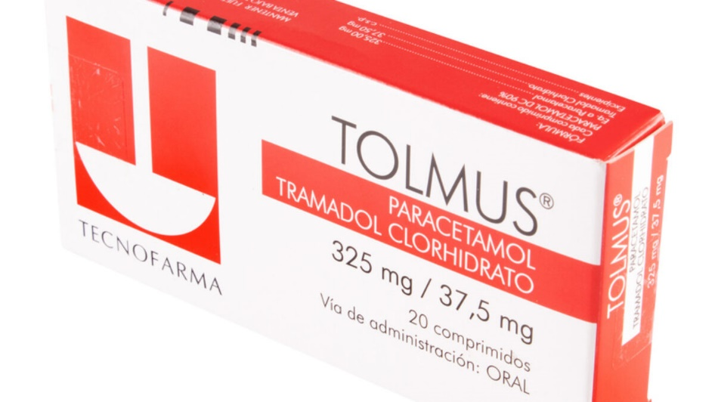
NF
TRAMADOL+ACETAMINOFEN (37,5+325)MG
TOLMUS TECNOFARMA $12.372
BENZIRIN VERDE ASEPTIC 120 ML
$27.840
B-VIT HT 3 AMPS JERINGA PRELLENADA $53.840

Slide 4

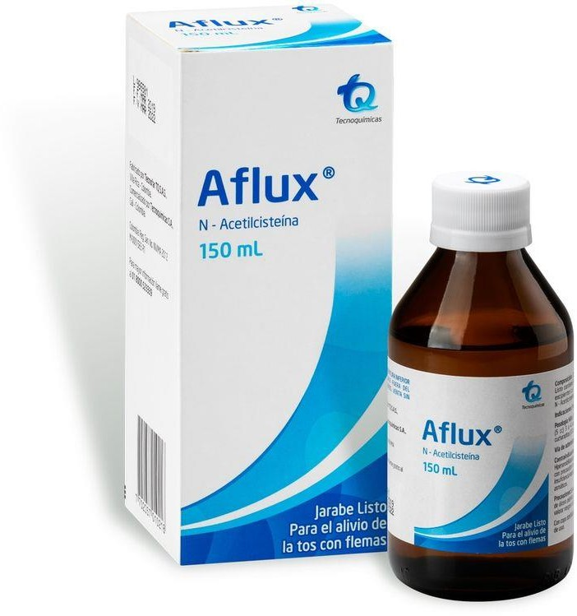
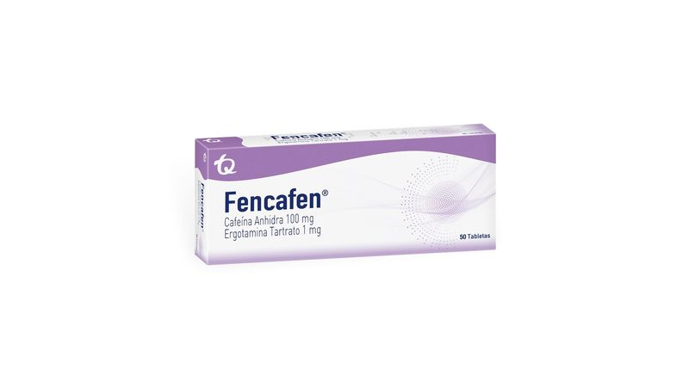
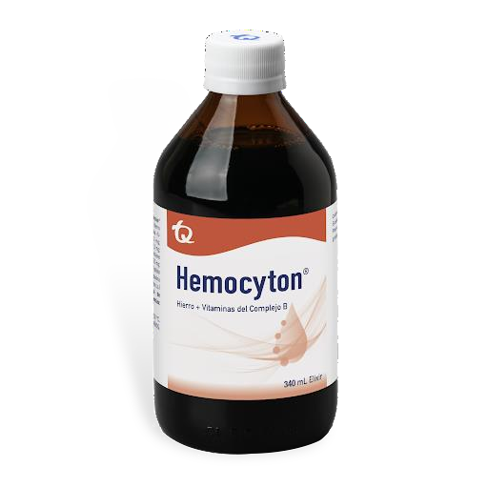
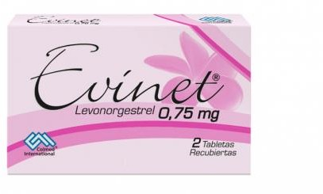
NF
FENCAFEN X 50 TAB - TECNOQUIMICAS
$20.970
AFLUX (N-ECETILCISTEINA) JARABE LISTO 150 ML TQ $24.800
EVINET 0.75 MG X2 TB - COLMED $4.900
HEMOCYTON JARB X240 ML - TECNOQUIMICAS $18.980

Slide 5

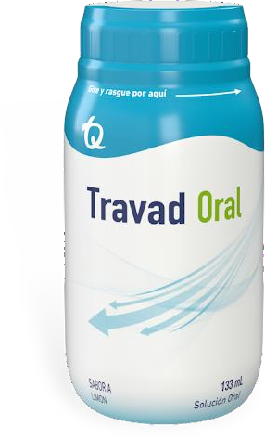
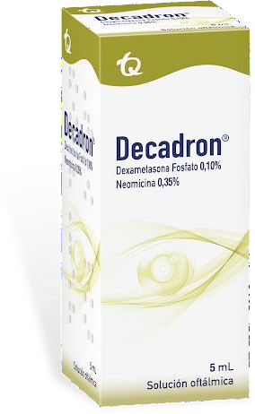
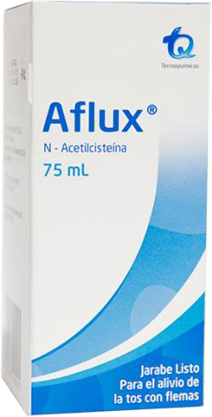
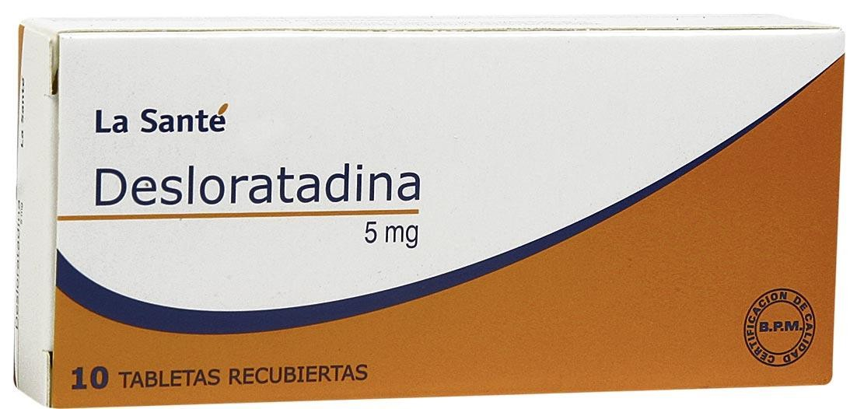
NF
DECADRON 1% X 5 ML SOLUCION OFTALMICA $16.278
TRAVAD ORAL SAB LIMON SOL ORAL 133 ML
TQ $13,860
AFLUX (N-ECETILCISTEINA) JARABE LISTO 75 ML TQ $19.800
DESLORATADINA 5MG X 60 TABLETAS
LA SANTE $29.800

Slide 6
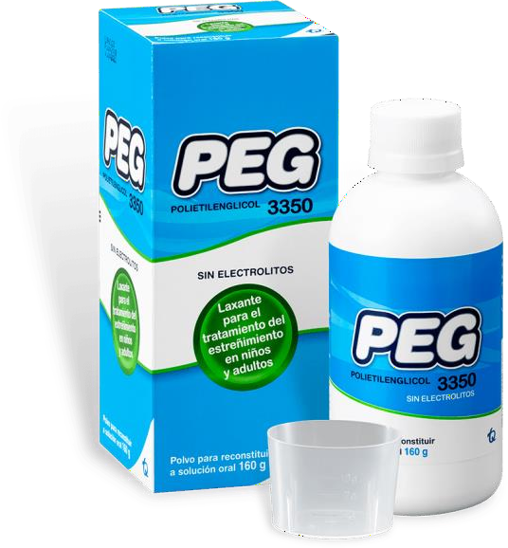
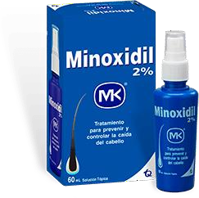
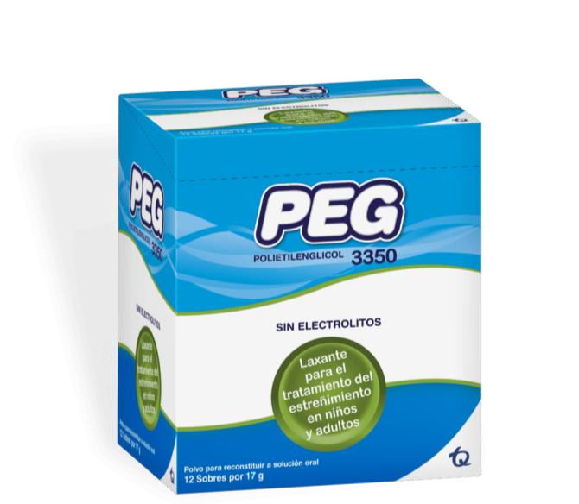
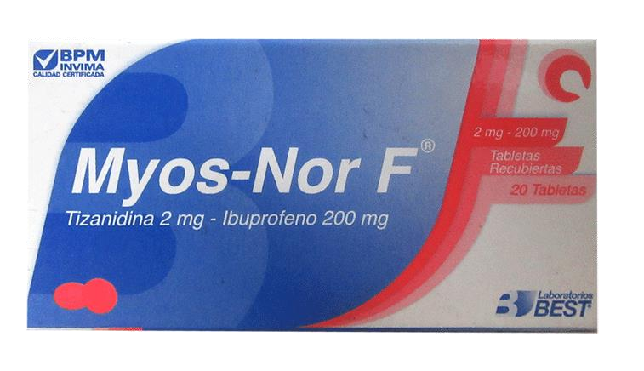
NF
PEG POLIETILENGLICOL 3350 SUSP 160 TQ - $34.900
MINOXIDIL 2 % LOCCION TOP 60 ML MK $27.480 - 3 x $25,000
MYOSNOR-F 2MG/200 (TIZANID+IBUPROF) 20 TAB $29.864
PEG POLIETILENGLICOL 3350 12 SOBRES TQ $39.457

Slide 7
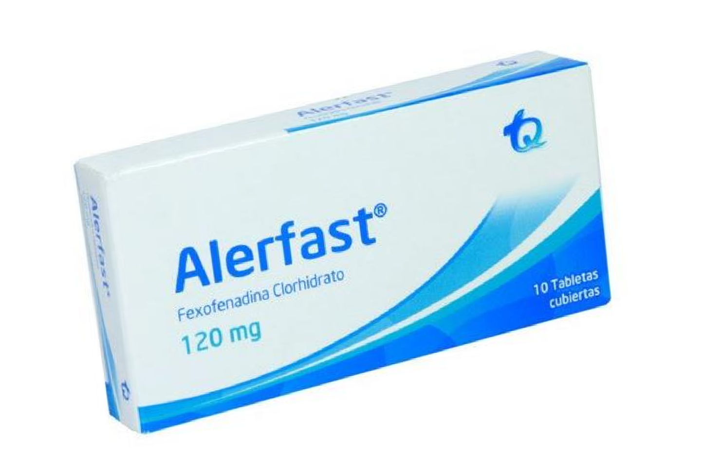
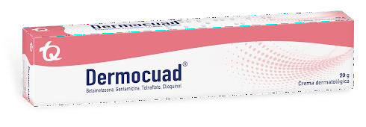
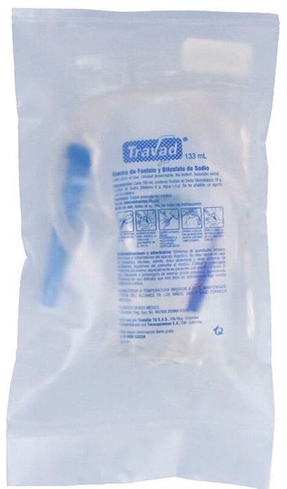
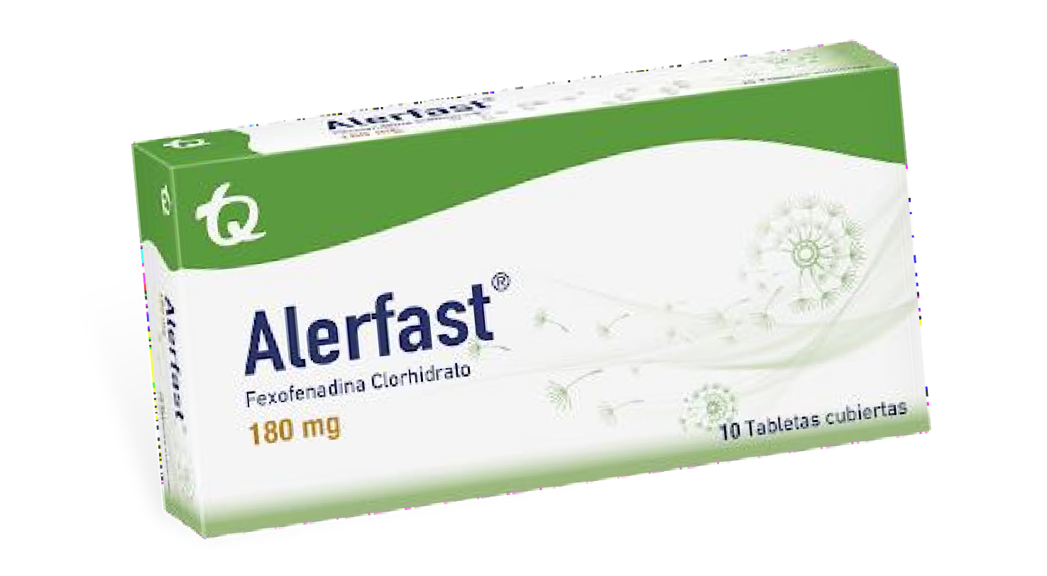
NF
ALERFAST (FEXOFENADINA CLORHIDRATE) 120 MG X 10 TAB $19.700
DERMOCUAD 20G - TQ
$16.800
TRAVAD RECTAL - TECNOQUIMICAS
$13.840
ALERFAST (FEXOFENADINA CLORH 180 MG) * 10 TAB TQ $17.588

Slide 8
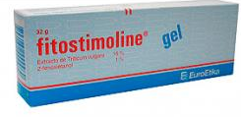
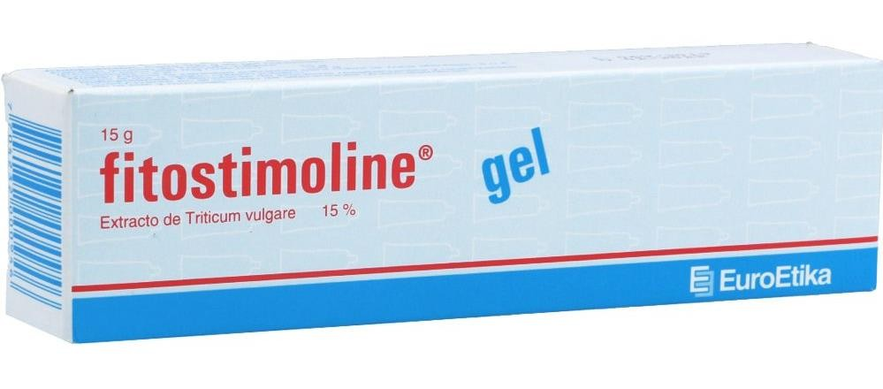
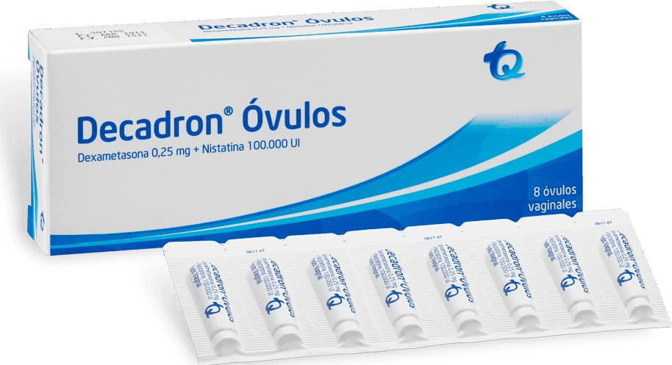
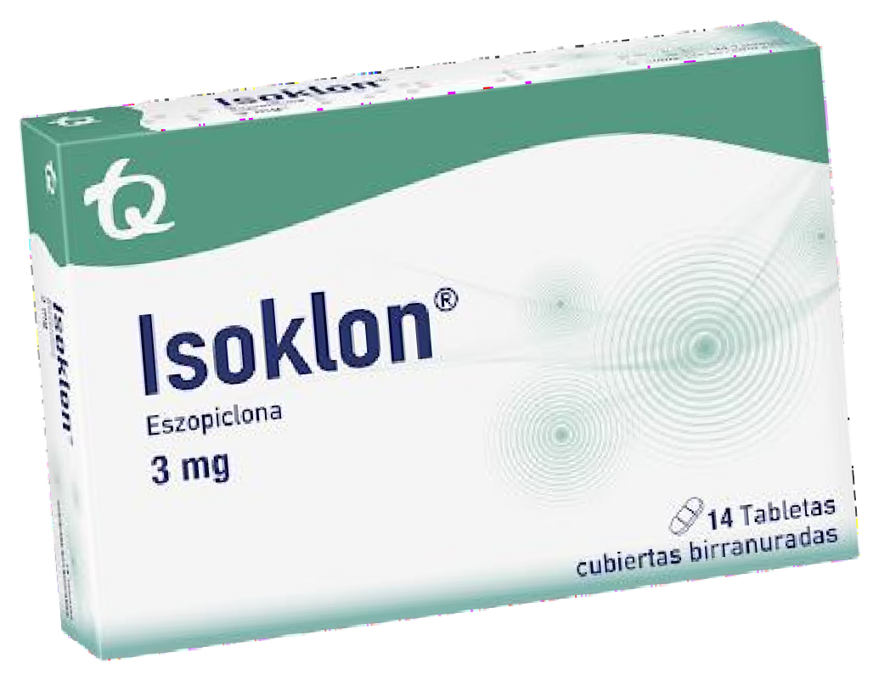
NF
FITOSTIMOLINE GEL 15 GR
$27.876
FITOSTIMOLINE GEL 32 GR
$49.876
DECADRON OVULOS (DEXA + NISTATINA) 8 OVULOS $22.850
ISOKLON (ESZOPICLONA) 3 MG 14 TABLETAS
$29.118

Slide 9
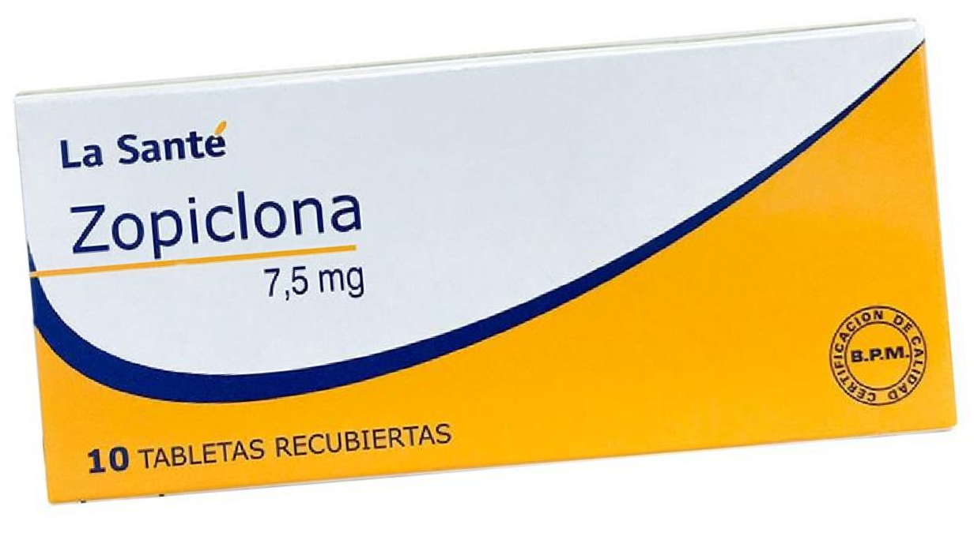
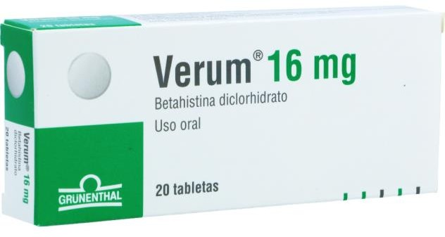
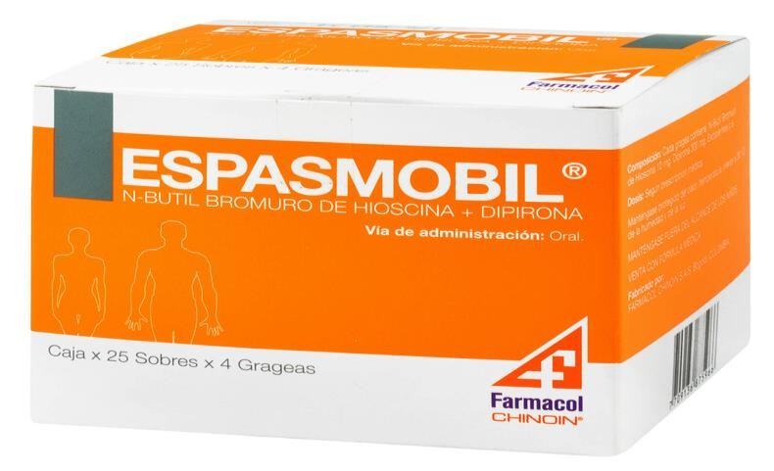
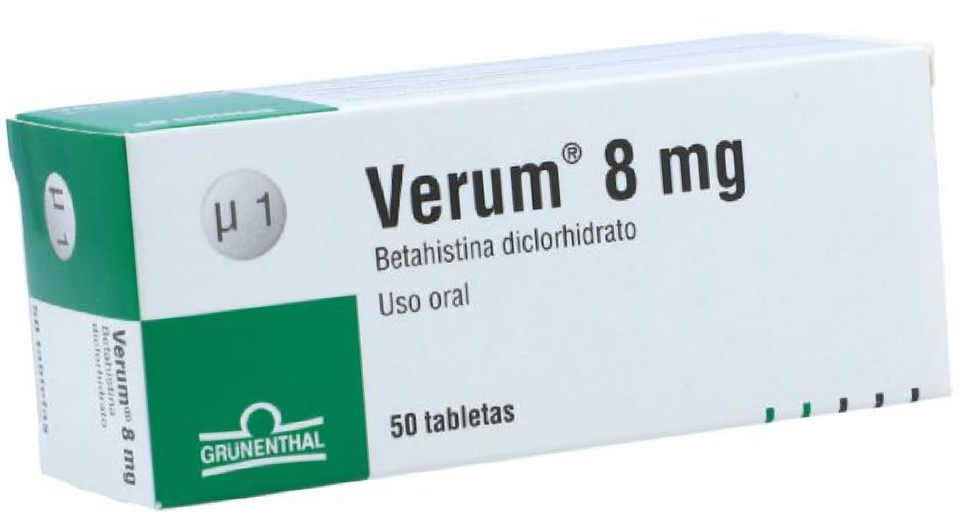
NF
ZOPICLONA 7,5 MG 10 TAB
$11.980
VERUM (BETAHISTINA) 16 MG 20 TABLETAS $19.400
VERUM (BETAHISTINA) 8 MG 50 TAB GRUNENTHAL $33.860
ESPASMOBIL (N BUT BROM HIOSCI+DIPI 10/300)* 100 TAB $99.000

Slide 10
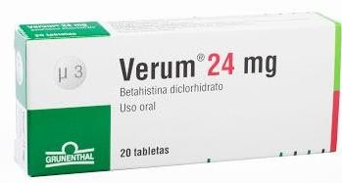
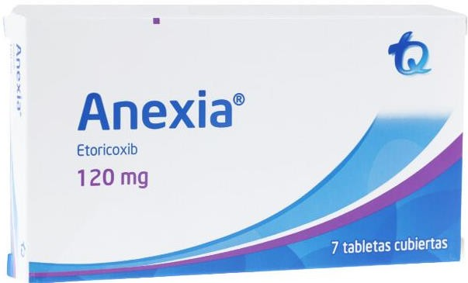
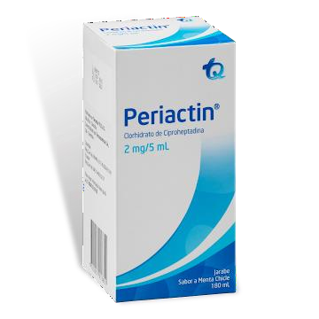
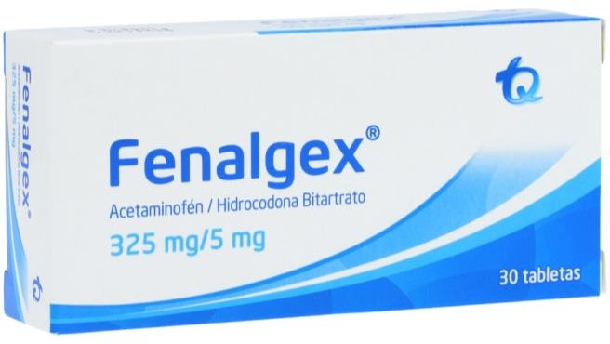
NF
VERUM BETAHISTINA DICLORHIDRATO 24MG 20 TAB
$28.460
ANEXIA ETORICOXIB 120 MG 7 TABLETAS –TQ
$19.000
FENALGEX (ACETAMINOFEN/HIDROCODONA) 325MG/5 * 30 TABLETAS $19.840
PERIACTIN 2 MG/5 ML MENTA CHICLE 180 ML $31.780

Slide 11
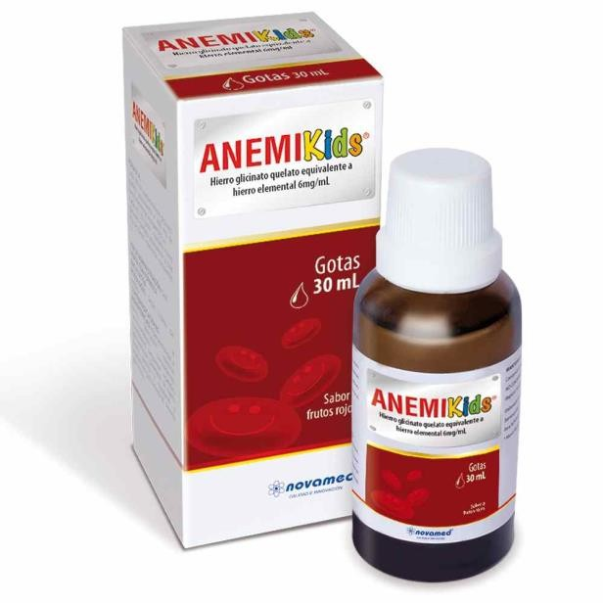
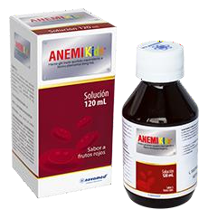
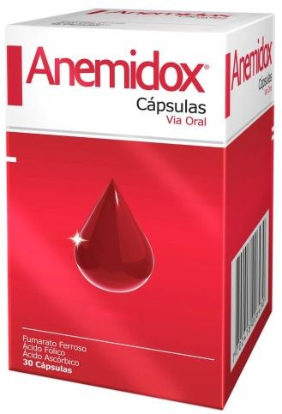
NF
ANEMIKIDS GOTAS 30 ML $19.800
ANEMIKIDS SOLUCION 120 ML $24.800
ANEMIDOX (100+1+330) MG X 30 CAP
$89.750

Slide 12
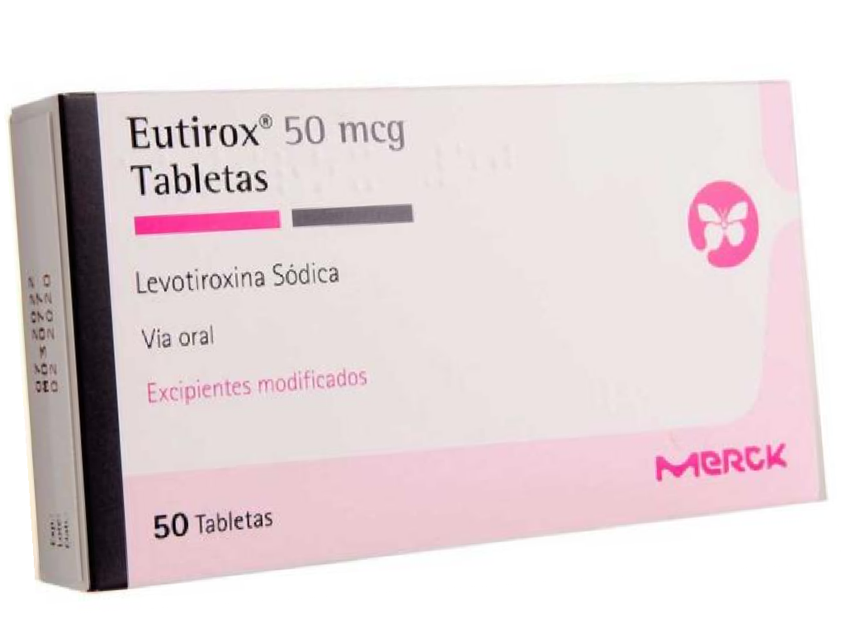
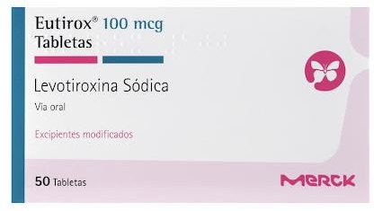
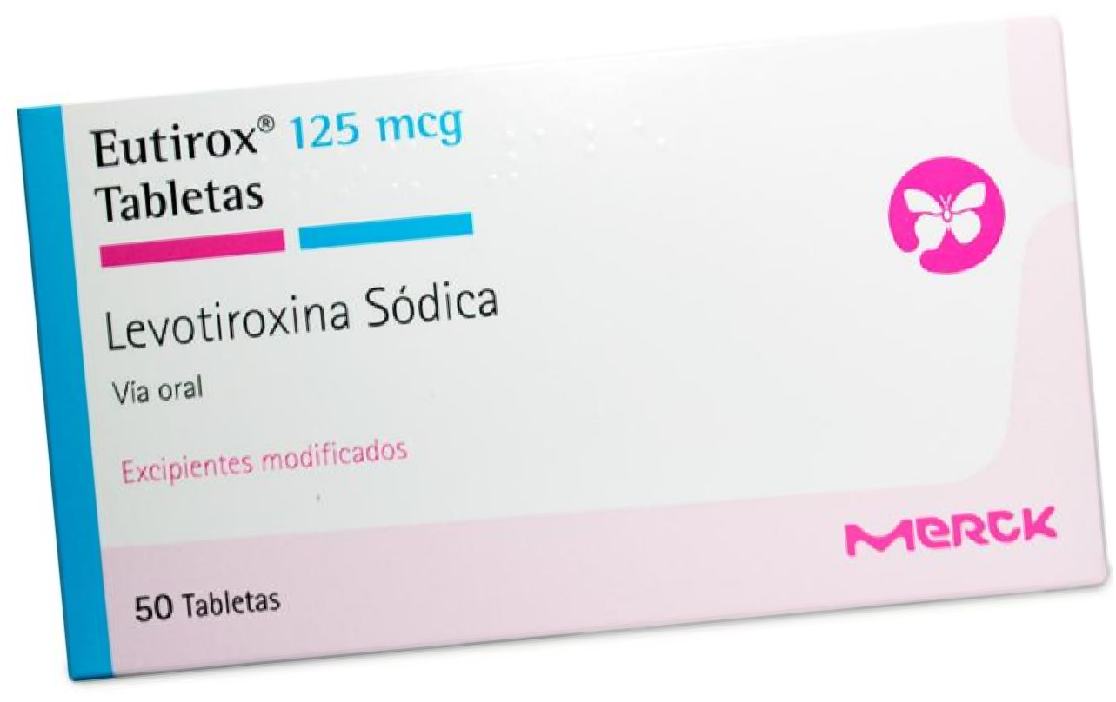
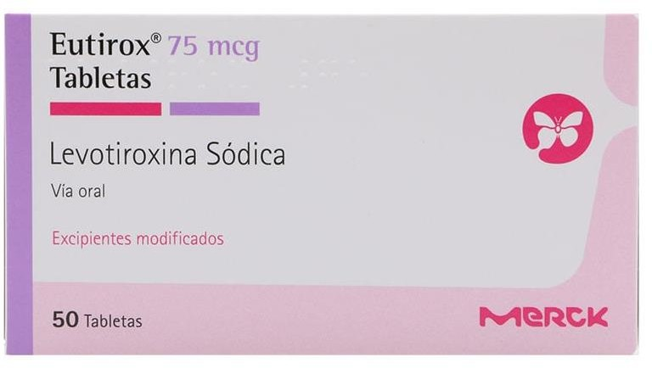
NF
EUTIROX (LEVOTIROXINA 50 MG) * 50 TAB MERCK $17.840
EUTIROX (LEVOTIROXINA) 100 MCG 50 TABLETAS MERCK $19.432
EUTIROX (LEVOTIROXINA 75 MG) * 50 TAB MERCK $21.364
EUTIROX (LEVOTIROXINA) 125 MCG 50 TABLETAS MERCK $31.964

Slide 13
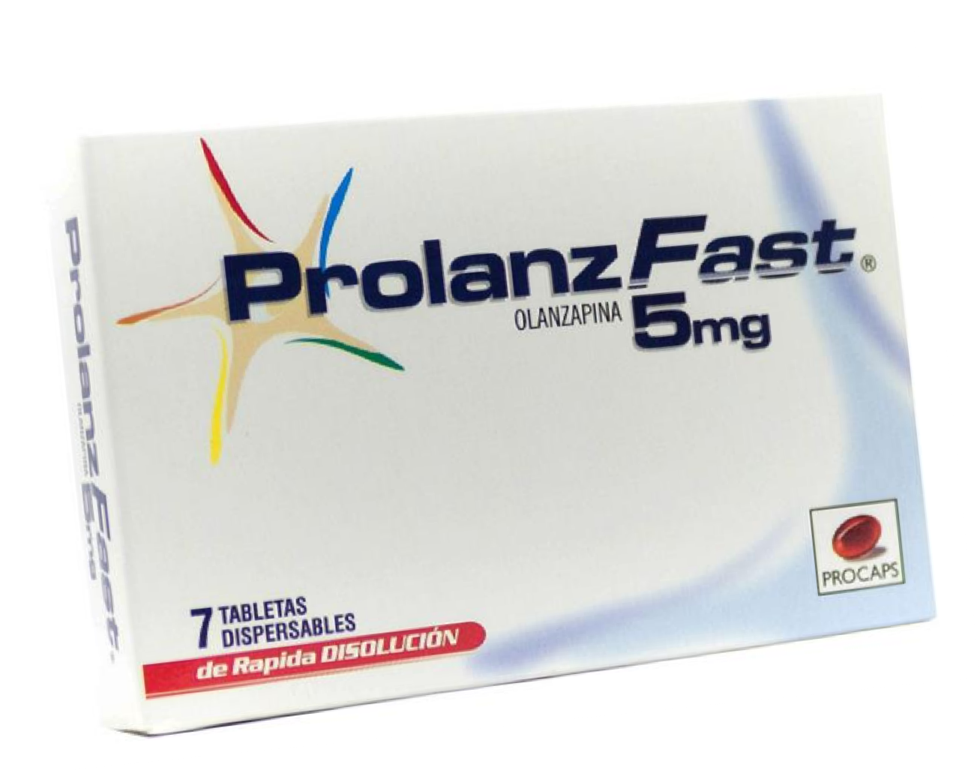
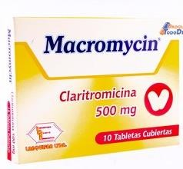
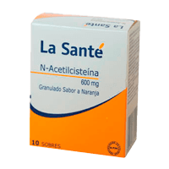
NF
PROLANZ FAST (OLANZAPINA5 MG) * 7 TAB PROCAPS $26.849
MACROMYCIN CLARITROMICINA 500 MG 10 TABLETAS $15.780
ACETILCISTEINA 600MG 10 SOB GRN LA SANTE $13.451

Slide 14
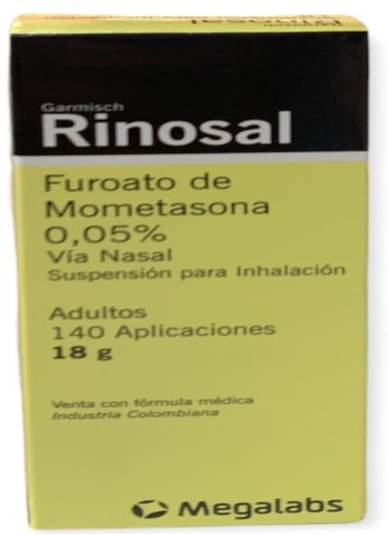
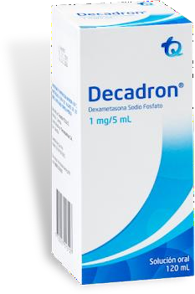
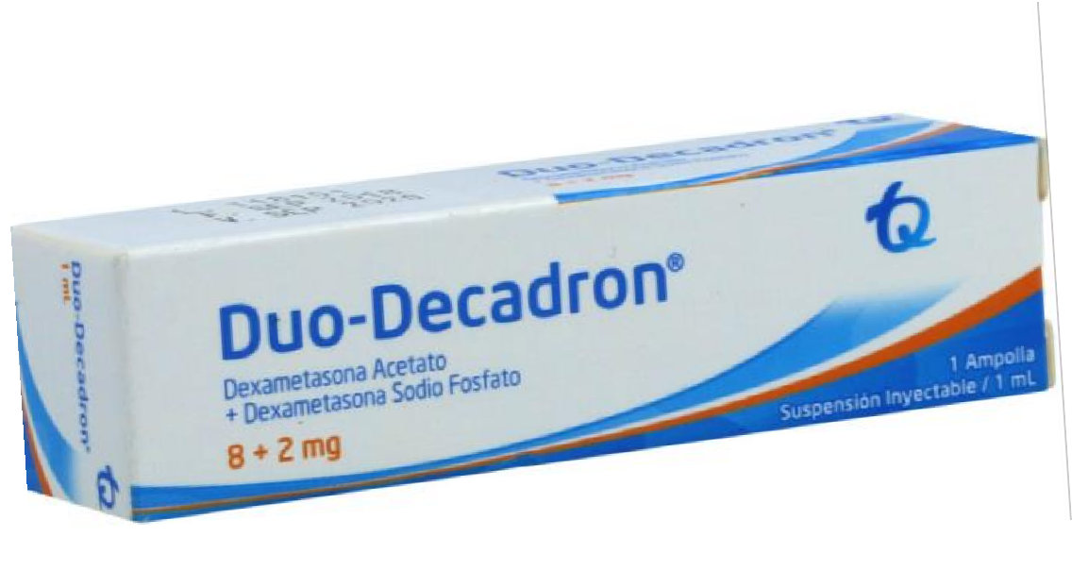
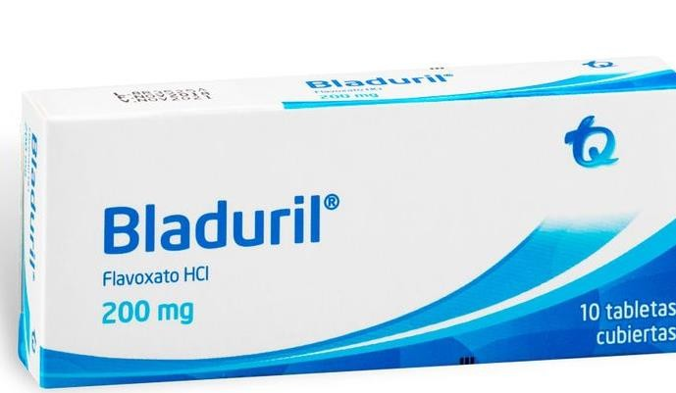
NF
RINOSAL (MOMETASONA) SPRAY NASAL 0,05% 18G $23.768
DECADRON SUSPENSION 120 ML(3%+)
$67.250
DUODECADRON 1 ML - TECNOQUIMICAS
$16.800
BLADURIL 200 MG 10 TABLETAS - TECNOQUIMICAS $59.965

Slide 15
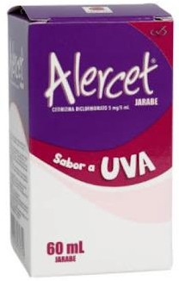
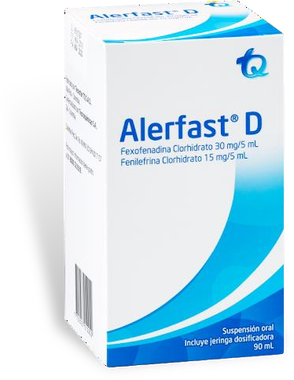
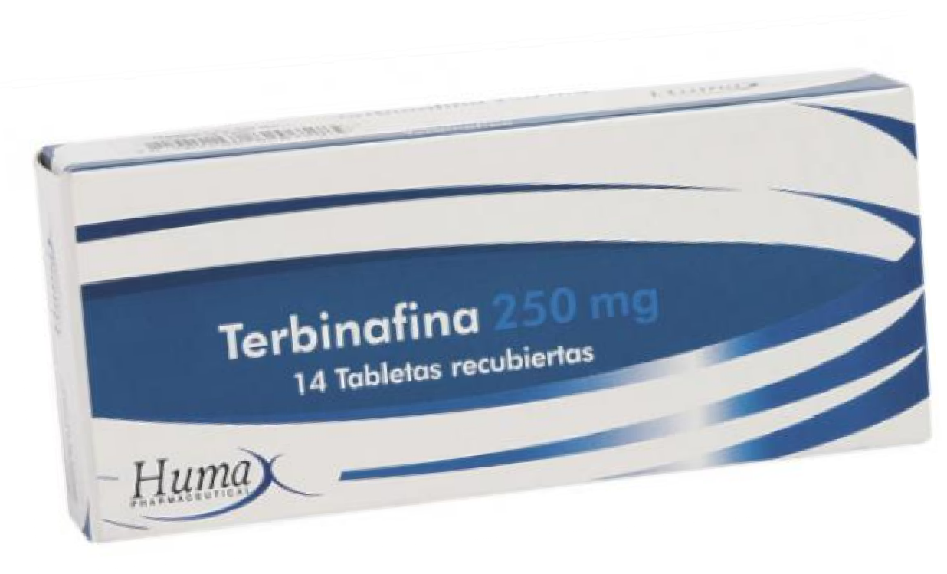
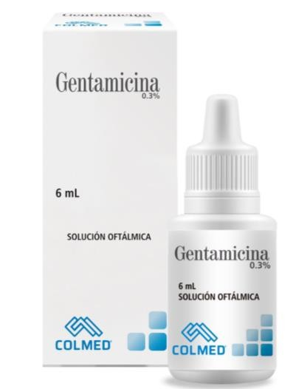
NF
CETIRIZINA 5MG/5ML JB X 60 ML
(ALERCET) PROCAPS $19.780
ALERFAST D (FEXOFENA-FENILEFRI)* 90 ML
TQ $29.769
TERBINAFINA 250 MG 14 TABLETAS HUMAX
$16.894
GENTAMICINA 0 3% OFTALMICA 6 Ml
$3.481

Slide 16




NF
DECADRON 8MG 2ML TECNOQUIMICAS $9.800
APOTOX (SILIMARINA) 150 MG CAJA X 20
$13.800
ALERCET (CETIRIZINA) 10 MG 10 TABLETA $11.842
DOLIREN (ACETAMINOFEN+HIDROCODONA) 325/5MG 100 TAB $59.732

Slide 17




NF
ZINKIDS SULFATO DE ZINC JARABE 120 ML
$13.177
OTOSEC HC (CIPROFLOXACINA+HIDROCORTISONA) 0 3% GOT $26.780
NITAZOXANIDA NYTAX
SUSPENSION 60 ML $28.940
LAGRIMAS ART FREEGEN GOTAS 15 ML(CARBOX) $23.920

Slide 18




NF
CLARITROMICINA 500MG CAJ X 10 TAB GENFAR $15.336
ETORICOXIB 120 MG X 7 TAB RECUBIERTAS MOMENTA $16.870
CARBIDOPA LEVODOPA 25 MG/250 MG X30 GENFAR $17.860
DAFLON 500 MG * 450MG DIOSMINA/50MG HISPERIDINA X 30 CAP $36.000

Slide 19




NF
ANEXIA (ETORICOXIB 60 MG) * 14 TABLETAS TQ $30.695
OFTAMOX D (MOXIFLO+DEXAME) *5ML TECNOQUIMICAS $29.000
DORZOPT SOLUCION OFTALMICA
$16.520
QUANOX 0 6% GOTAS FCO 5 ML SIEGFRIED $7.786

Slide 20




NF
OFTALMOTRILOL TIMOLOL 5MG/ML SOL.OFT 5 ML INCOBRA $5.300
CITRAGEL 1500 MG 30 TAB PROCAPS
$29.865
OFTAMOX(MOXIFLOXACINA)0.5%* 5 ML TQ $16.780
SINALGEN MAX(ACETAMINOFEN+HIDROCODONA) 325/10MG $75.200

Slide 21




NF
ADORLAN (DICLOFENACO+TRAMADOL) 25 MG 20 CAP $28.870
APRONAX 550 MG 20 TABLETAS
$38.486
RINOTADIN DESLORATADINA 5 MG X 10 TAB $6,800
DEFEROL (VITAMINA D3) 2000UI 60 CAP PROCAPS $21.544

Slide 22




NF
SULTAMICILINA 750 MG 10 TABLETAS LS
$48.992
GESTAVIT MATERNO 30 CAPSULAS
PROCAPS $25.840
NITAZOXANIDA 500 MG * 6 TAB LASANTE
$11.450
ANEXIA ETORICOXIB 120 MG 7 TABLETAS
$19.870

Slide 23




NF
NAFAZOL (OXIMETAZOLINA 0.5%) FCO 15 ML $9.300
STAFEN (ACIDO FENOFIB+ROSUVASTA 135/20 MG 30 CAPS $147.980
BETAHISTINA 8 MG 20 TABLETAS LS
$12.870
OLOPATADINA 0.2% X 5 ML
OFTALMOTRIALER $11.500

Slide 24




NF
TOBRADEX GOTAS 5 ML ALCON $24.894
TOBRACORT 3% GOTAS 6 ML PROCAPS
18.946
SULTAMICILINA 375 MG 10 TABLETAS LS
$28.694
SILIMARINA 150MG X 20 TAB GENFAR $17.450

Slide 25

Portafolio listado M2

Slide 26




NF
BETADUO X 1 ML PREYENADO PROCAPS
$18.000
RETIBLAN VITAMINA A 50000 UI 50 CAPSULAS $8.900
TRIMEBUTINA + SIMETICONA X 10 TABLETAS (COLMED) 35.450
COMPLEJO B X 6 AMPOLLAS B- VIT PROCAPS $39.870

Slide 27




NF
100
ESOMEPRAZOL 40 MG X 100 TAB – COLMED
$21.600
100
ESOMEPRAZOL 20 MG X 100 TAB – COLMED
$19.800
NODOL FORTE X 100 TB - SP
$27.900

Slide 28




NF
PANGETAN NF LOPERAMIDA CLORHIDRATO 2MG 100 TAB – TQ 128.800
LEVOMEPROMAZINA 25 MG X 100 TAB $38.470
BETADUO 2 ML JERINGA PRELLENADA
$29.960
TAMSULOSINA CLORH 0,4MG X 100 TAB
$68.860

Slide 29




NF
NODOL PLUS (ACETAM325MG+HIDROCOD5MG)
X100 TAB $31.900
RETIBLAN (VITAMINA A 100.000 UI) 50 CAPSULAS
$39.900
FEMELIN AMPOLLA X UND - LF
$9.900
METRONIST (METRONIDAZOL+NISTATINA)x 10 OVULOS COLMED $9.700

Slide 30




NF
METRONIDAZOL+CLOTRIMAZOL X 10 OVULOS
(FEMDUO) COLMED $9.800
ISOFACE (ISOTRETINOINA) 20 MG 30 CAP
$74.900
CYCLOFEM AMPOLLA UND
$9.943
OMEPRAZOL 20 MG X 300 CAPS - FARMACOL $26.745

Slide 31




NF
SINALGEN (ACETAMINOFEN+HIDROCODONA) 5/325MG 90 TAB $88.450
VALCOTE ER ACIDO VALPROICO 30 TABLETAS $26.400 - x $19,800
KETOROLACO 30 MG 5 AMPOLLAS GF
$9.500

Slide 32



NF
OFTALMOTRIMAX (POLIMIX/NEOMI/DEXAM)5 ML
$5.100
ZALDIAR 325 + 37.5 MG 20 TAB GRUNENTHAL
$14.900
B-VIT CAJA X 50 CAPSULAS BLANDAS PROCAPS $19.620

Slide 33



NF
DORZOLAM 2% 5 ML GOTAS
$23.598
WINADEINE F 325/30 MG 30 TABLETAS
$29.450
ESCITALOPRAM 20MG C*30 TAB (ESCITROLAM) – HETERO $19.774

Slide 34




NF
BROMURO DE IPRATROPIO (ASPROMIO) 20 MCG 200 DOSIS CHALVER $11.900
TOPIRAMATO SANDOZ 100 MG X 20
$24,860
BETAHISTINA DICLORHIDRATO 24MG
$29.500
BETAHISTINA 16 MG X 30 TABLETAS MOMENTA $12.870

Slide 35


NF
MIGRADOL (ERGOTAMINA+CAFEINA) 100 TAB SALUSPHARMA $39.657
B-VIT CAJA X 50 CAPSULAS BLANDAS PROCAPS $17.620
RUVAX ROSUVASTATINA 40 MG 30 TAB HUMAX
$11.990

